Slide 1
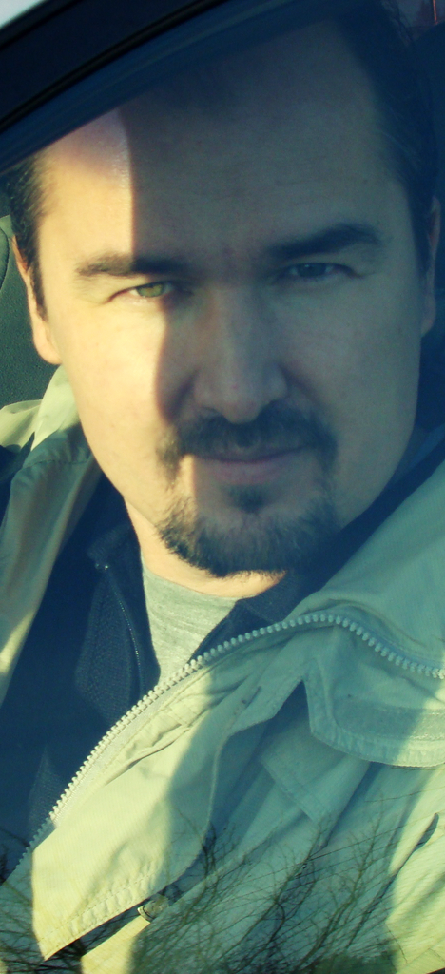
TimurSAfin
Timur Safin
Visual Résumé 2.0

Slide 2
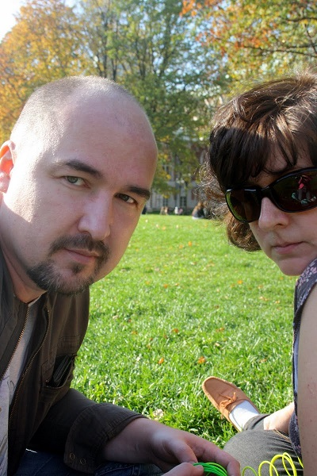


InBrief:
INBrief:
Age: 42
Married
Child: Girl - Gulnara
Grand Child: Boy – Dima*
* this is complicated

Slide 3

Education
Education
In the 1994 after 6 years of studying CAD
I’ve graduated from the Moscow Institute of Electronics and Mathematics

Slide 4
Large connections network
Large connections network
More than 20+ years in the software industry means a lot of connections
Let try to estimate it “scientifically”

Slide 5
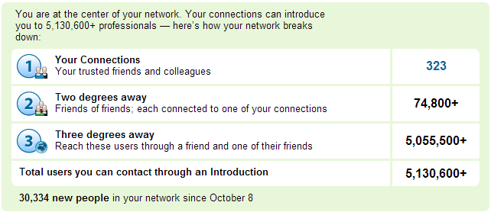
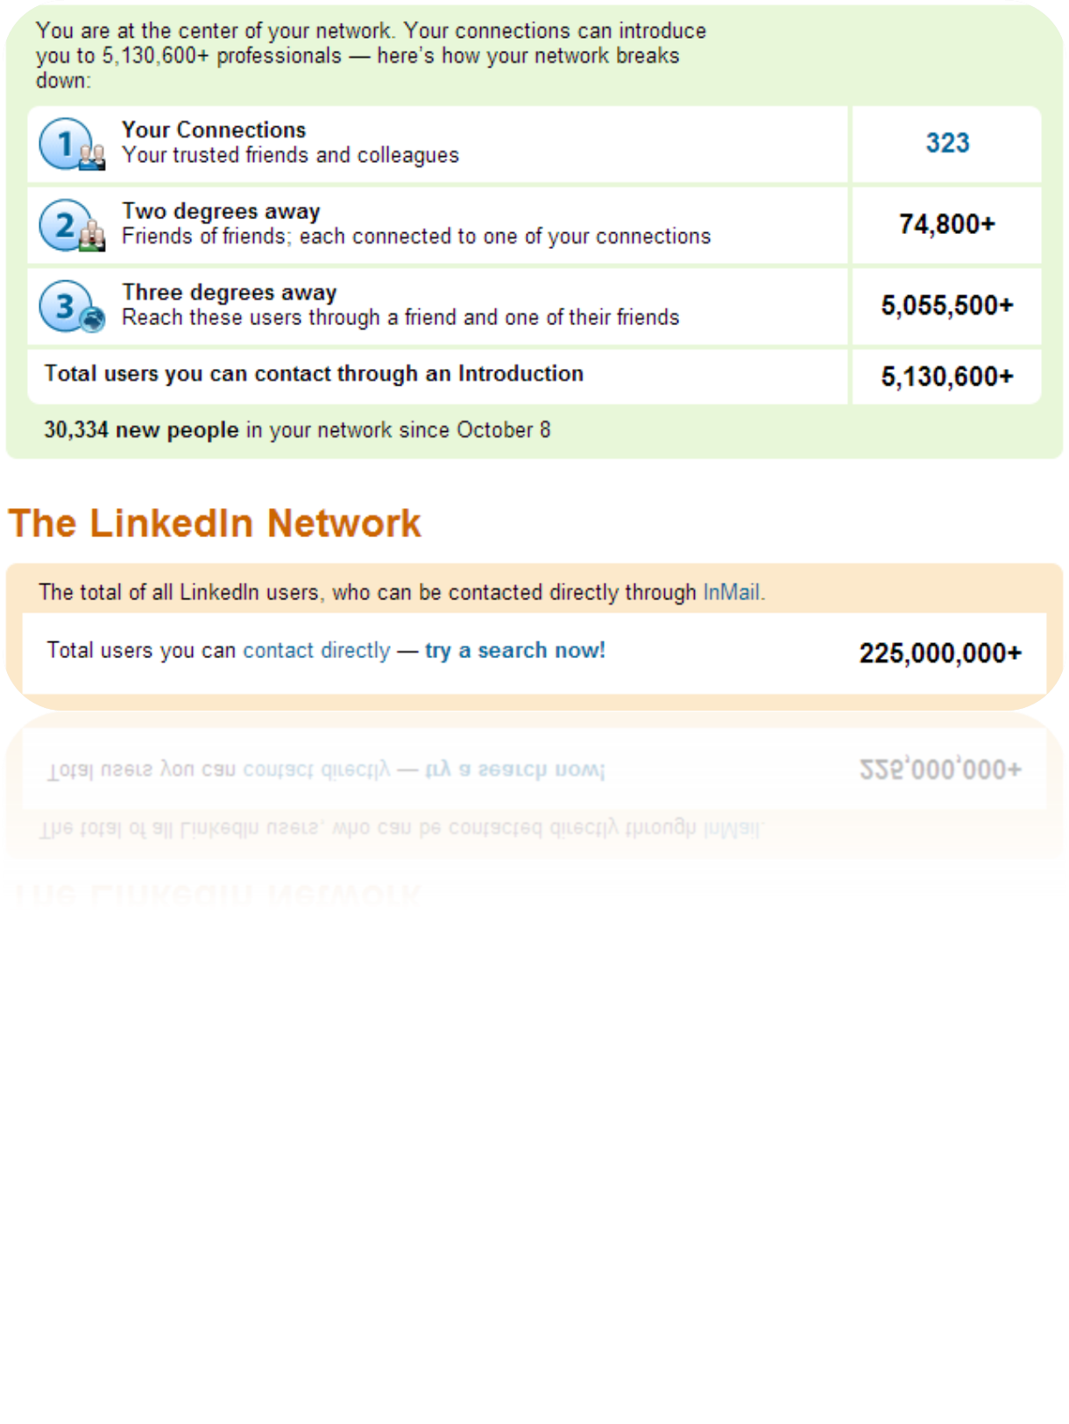
…using LinkedIn stats
Surprisingly I know all of those 323. Well almost all
May be with the exception of some HR/recruitment people…

Slide 6
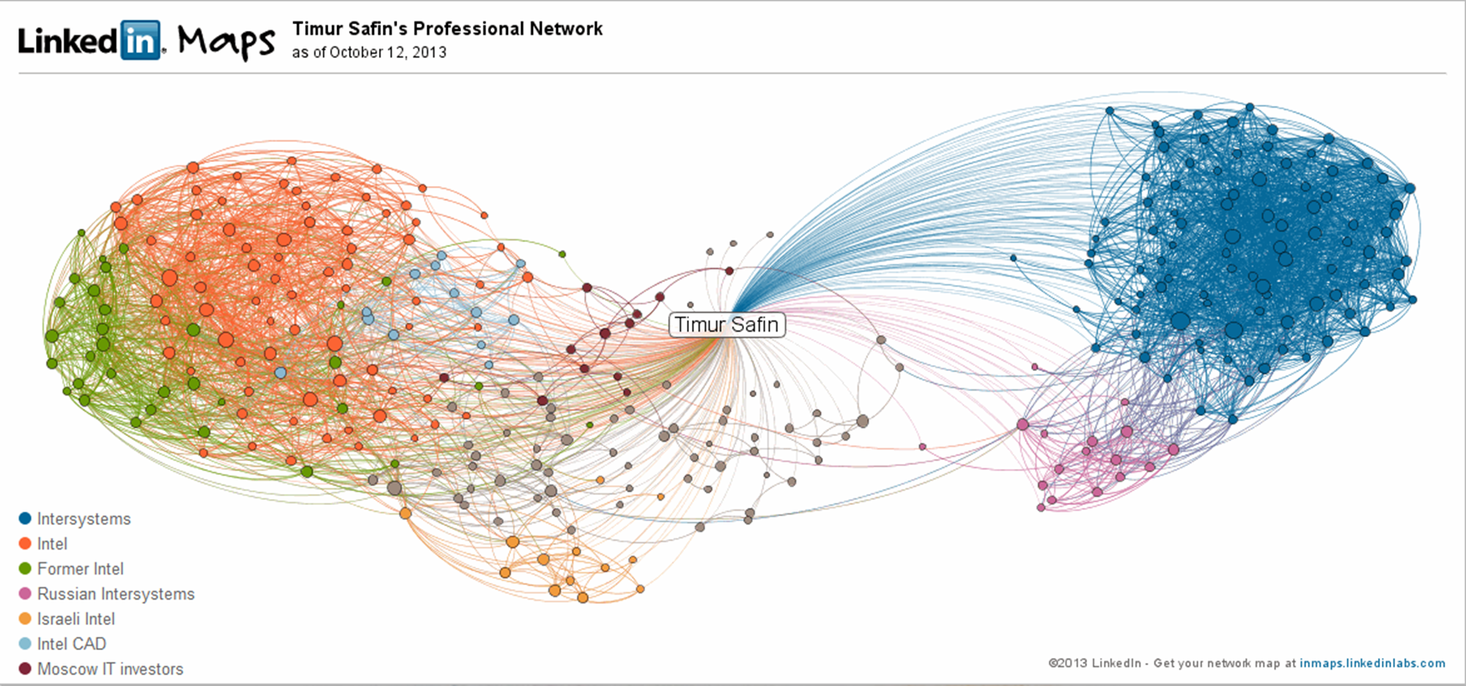
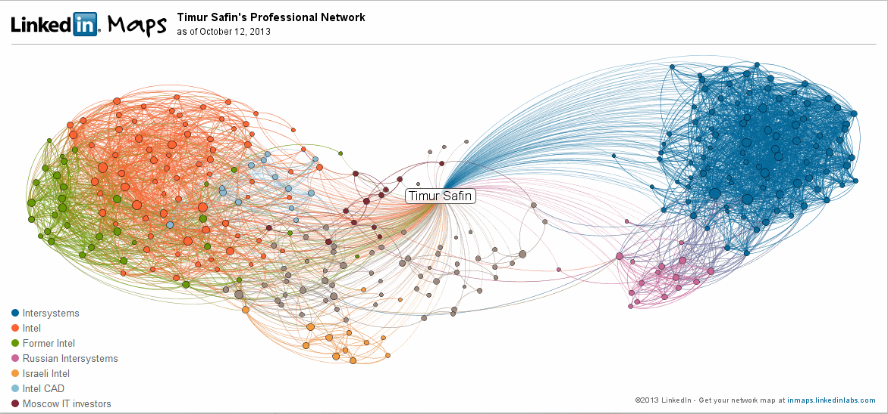
Or as a graph…
Or as a graph…

Slide 7
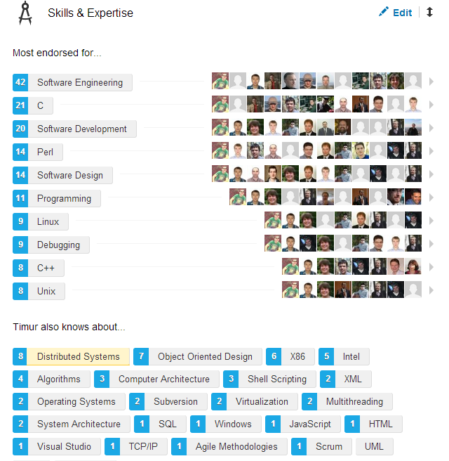
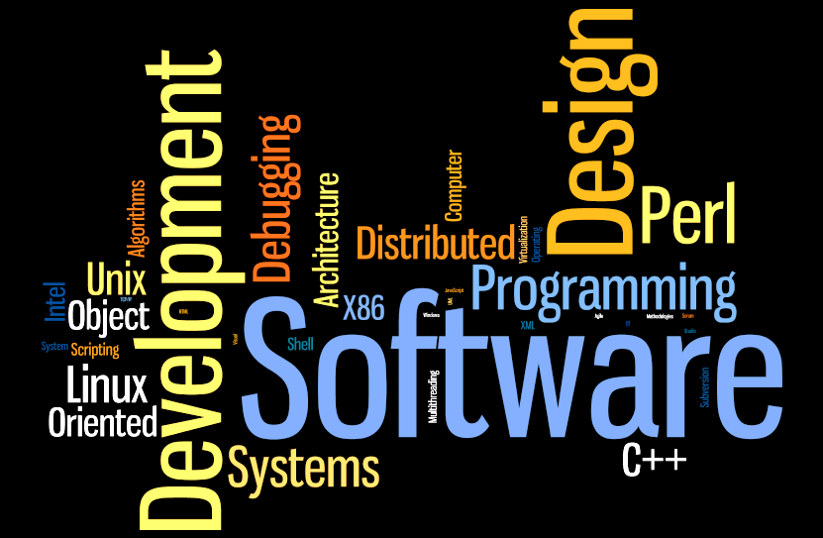
My SKILLS as them seen externally

Slide 8

Jobs
JOBS
Enough of abstract skills!
Let see how and where I’ve gathered them

Slide 9

Inzer aka Steepler Soft
1994
Inzer aka Steepler Soft
I’ve created translator the language in Windows GUI application constructor
And ‘ve continued development of the scripting engine for DataLine 2.0 – Windows BBS program
Inzer was the only Russian Windows development house, and unique experience
Corel Chart, CyrWin, WIM, FaxLine, Dataline – at least one of these should sound familiar for you

Slide 10

StatPro
1996
StatPro
Architected and developed multimedia courses
Have led web development for several sites
Sporadically done web design. But not many

Slide 11

Intersystems
2000
At the time free from debugging crash-dumps I was moderating Russian cache_ru community,
Actively participated in the world intersystem.public.cache group,
And teached customers on conferences and schools
Caché engine kernel is multi-platform (Windows, Linux, HP-UX, AIX, OpenVMS) and multi-CPU (x86/x64, Power, Alpha, PA-RISC, Itanium)
E.g. there was ~20 build targets of all product combinations
Intersystems is the Cambridge, MA based private company
Their main business is “post-relational” database Caché mostly known in the US healthcare
I was Backline Programmer and was working on fixing problems with kernel and utilities
From crash-dumps, to Windows NDIS packet-driver, or ActiveX controls changes

Slide 12

Intel SoftSDV
2006
Served as virtualization techlead in the x86 CPU team of SoftSDV full-system simulator
At the moment SoftSDV was a sole tool which could boot-up XEN, Vmware-ESX or Hyper-V with next generation virtualization technologies
https://noggin.intel.com/content/softsdv-a-pre-silicon-software-development-environment-for-the-ia-64-architecture

Slide 13
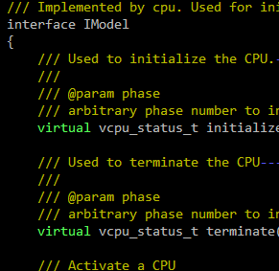
VCPUAPI
2008
As SoftSDV team delegate I’ve participated in the multi-team initiative to develop simulator agnostic CPU core API
Our proposal won and became the start of Virtual CPU core API
Now VCPUAPI is being used by several CPU core and virtual platform simulator inside and outside Intel
Simics, and Innovator VP are examples of such usage

Slide 14
Intel ZSIM*
2009
ZSIM is fast x86 instructions set simulator, created for experiments
Created by star programmers known before by Pin or XED/SDE
I was one of initial ZSIM developers
And worked on platform interfaces, paging and x64 mode
* http://www.cs.virginia.edu/kim/docs/wish11zsim.pdf

Slide 15
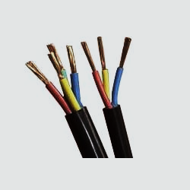
Intel “NEXT-GEN” CPU performance simulator
2010
I’ve worked on some parts of memory subsystems (core and uncore) for performance simulator
Also I’ve served as a “development technologies” lead which has brought code review, and agile/scrum to the team practice
Famous Soviet and Russian scientist Babayan B.A. leads development of next-generation processor architecture based on strands
No more details here. Sorry!

Slide 16
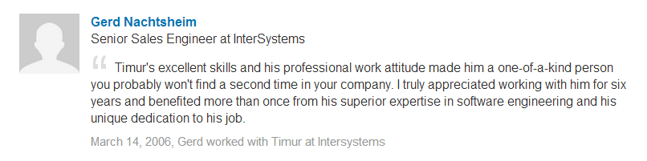
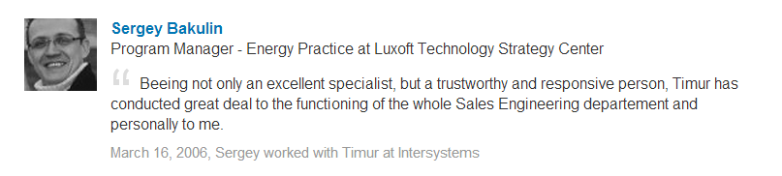
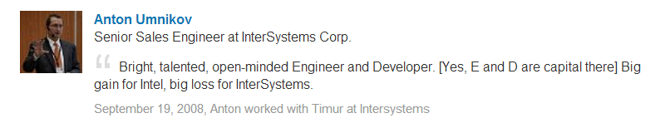
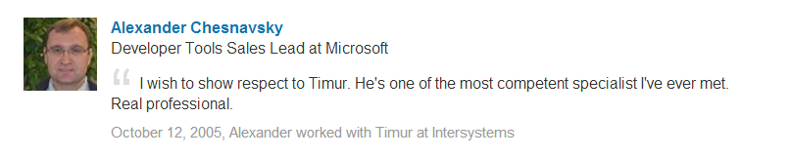
Quotes

Slide 17
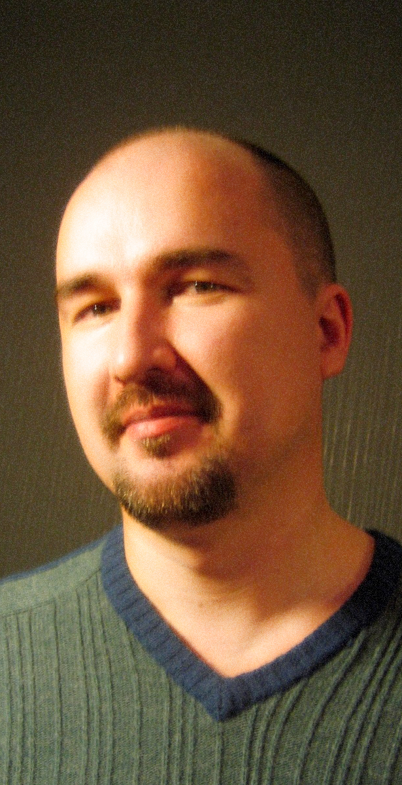
HONEST
CRISIS-RESISTANT
Now please say me
at least 1 reason
to not hire me?
OPEN-MINDED
FRIENDLY
TEAM PLAYER
EXPERIENCED
LOVE TO LEARN NEW
POSITIVE
ATTENTION TO DETAILS
LISTENING
FASILITATOR

